Slide 1


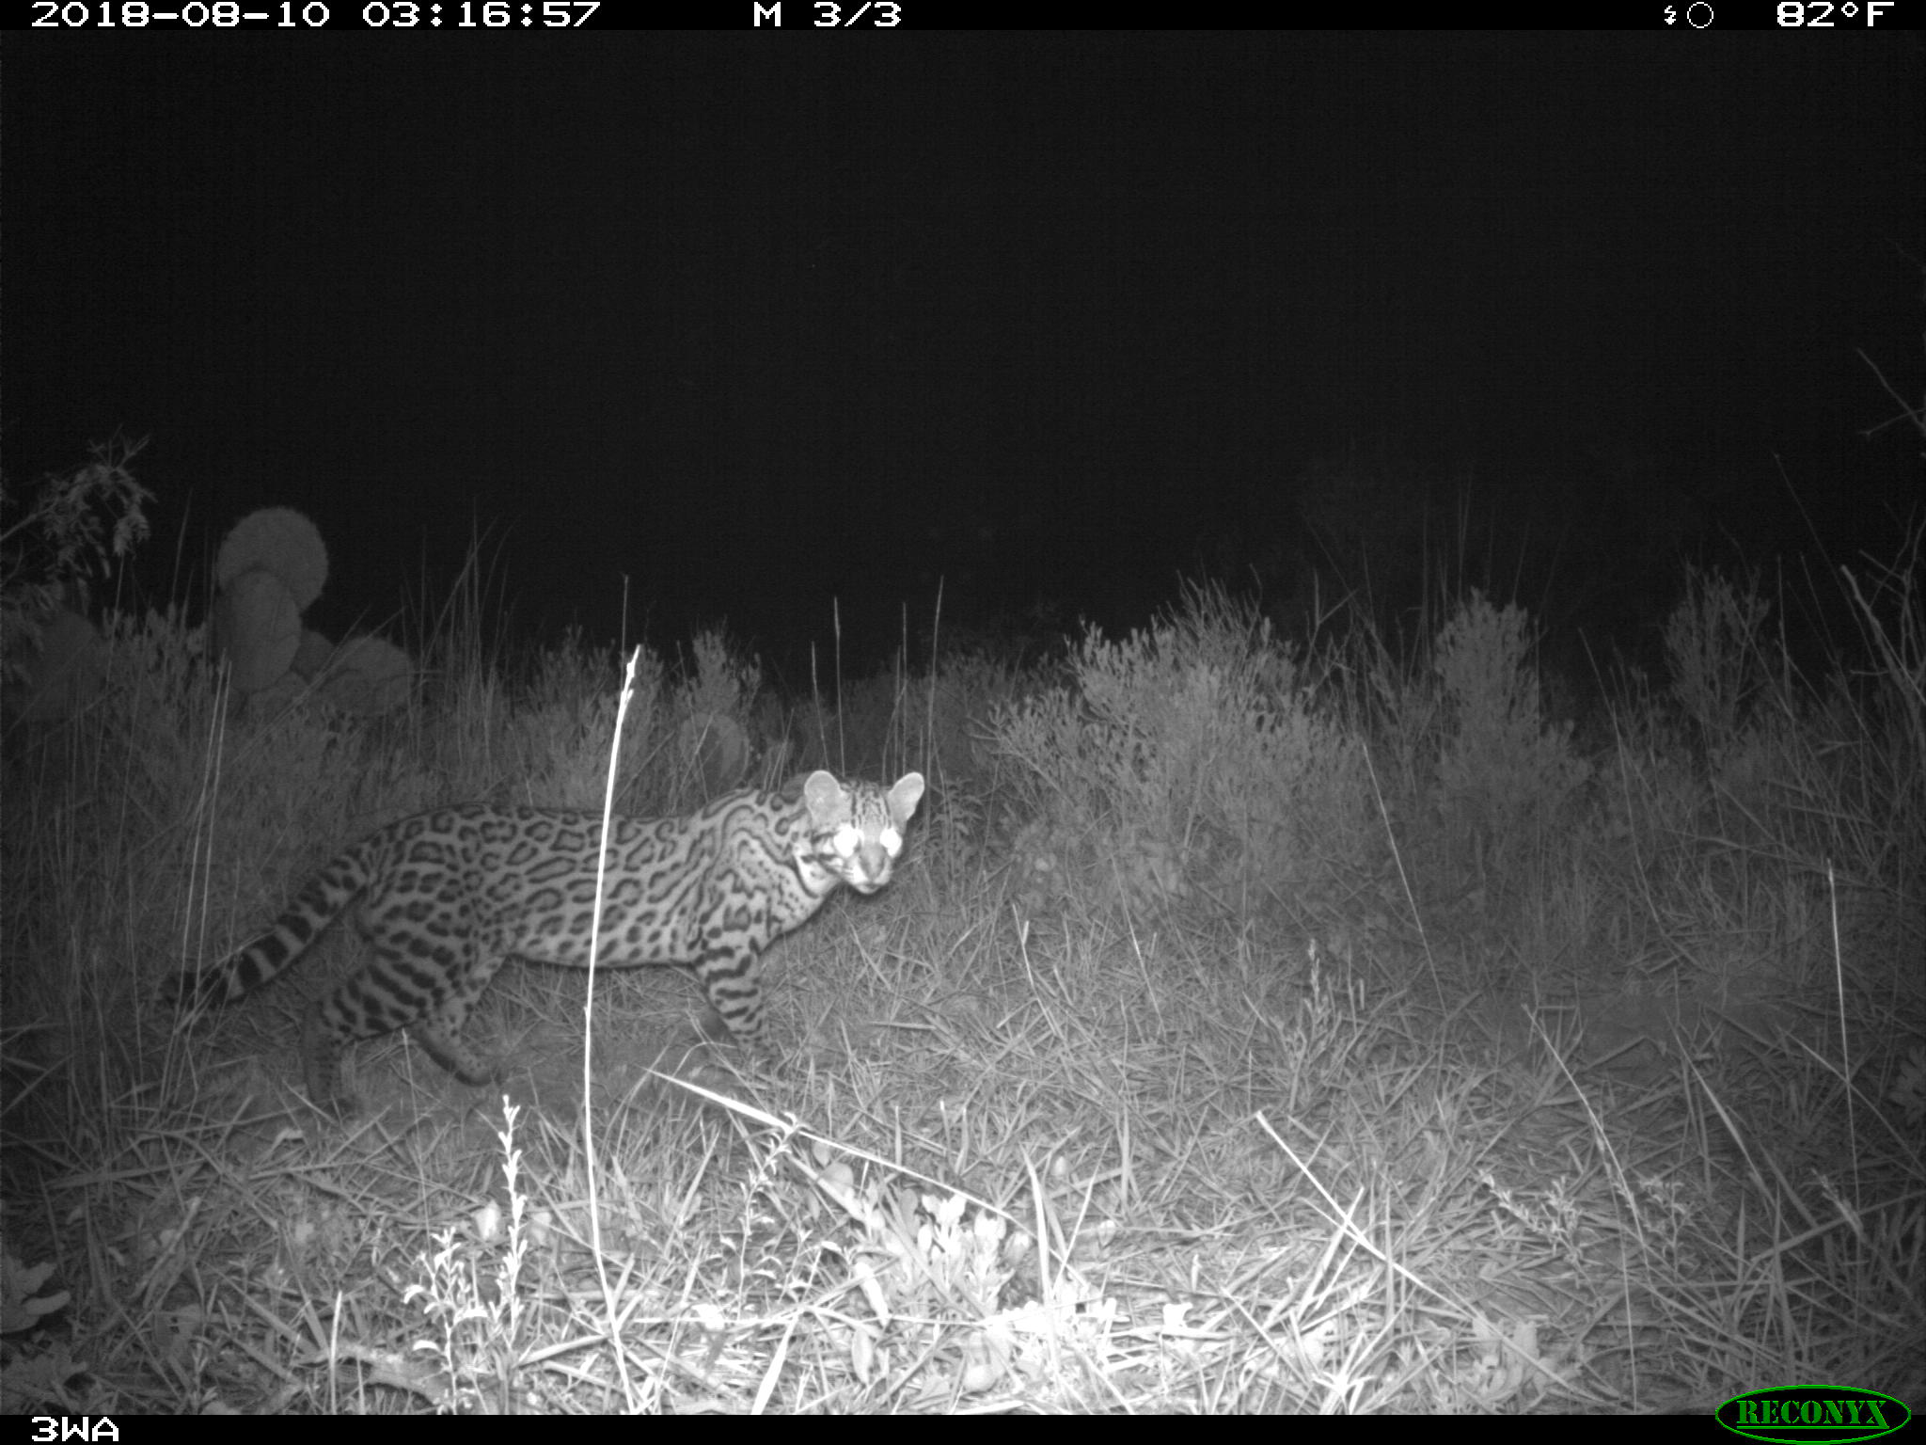
Updating emerging hot spot analysis to account for true zero values
Tom Yamashita
MARS 5470: Introduction to Scientific Programming
3/6/2019

Slide 2

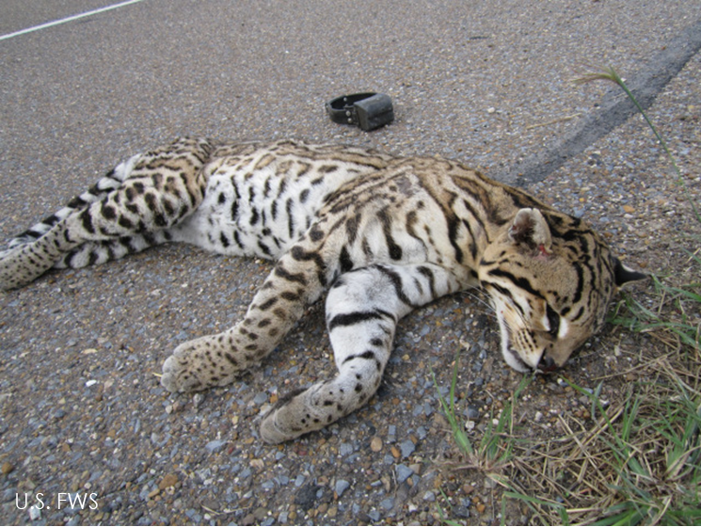
Background
Major threat to ocelots is collisions with vehicles
TxDOT has constructed exclusionary fencing, wildlife guards, and wildlife crossings on State Highway 100
Wildlife road mortality surveys conducted to identify what animals are hit most and where they are being killed
Individuals recorded to lowest taxonomic level and GPS coordinates taken
Surveys have been conducted since 2015 and will continue through 2023

Slide 3
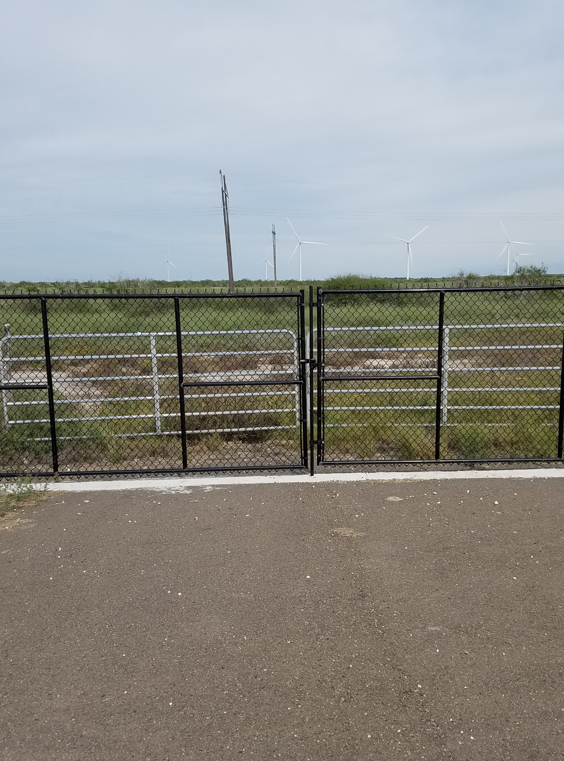
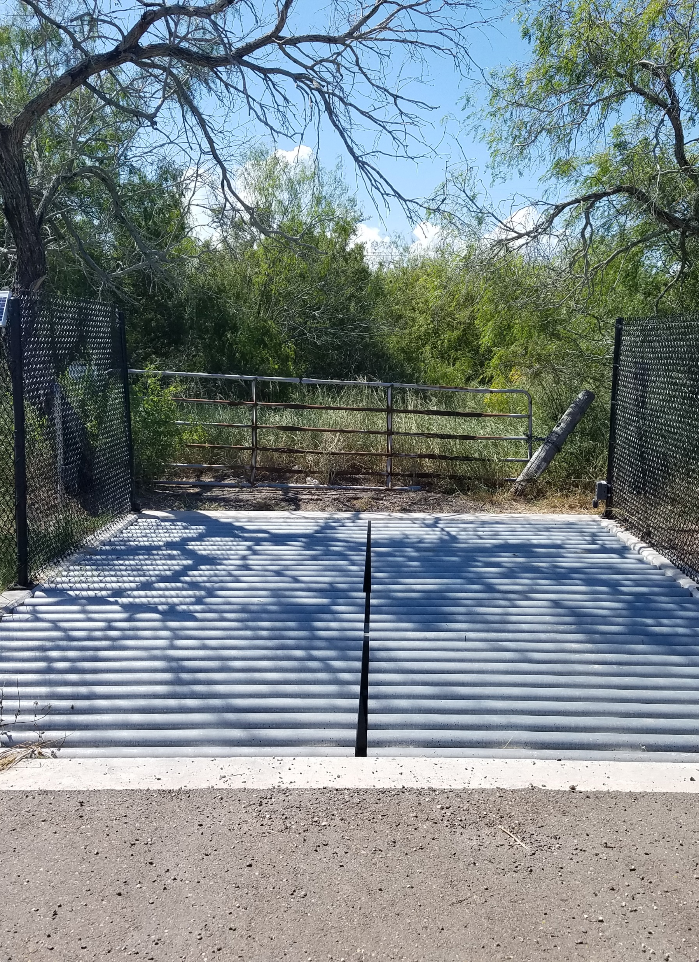
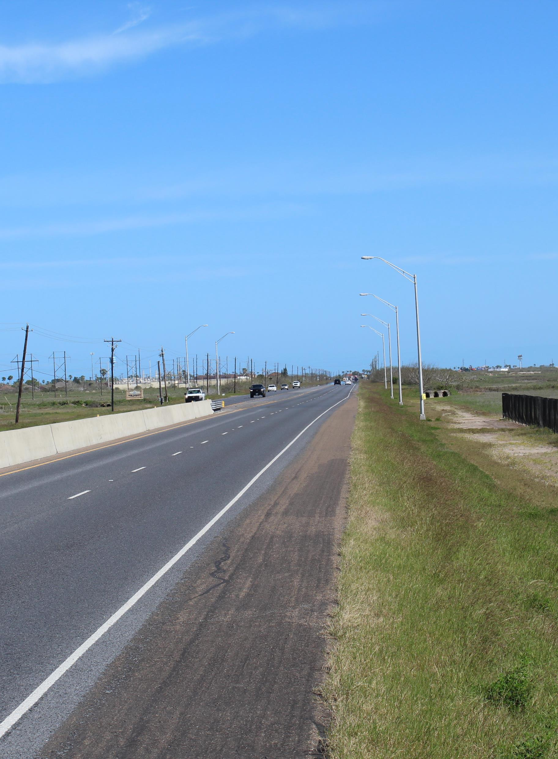
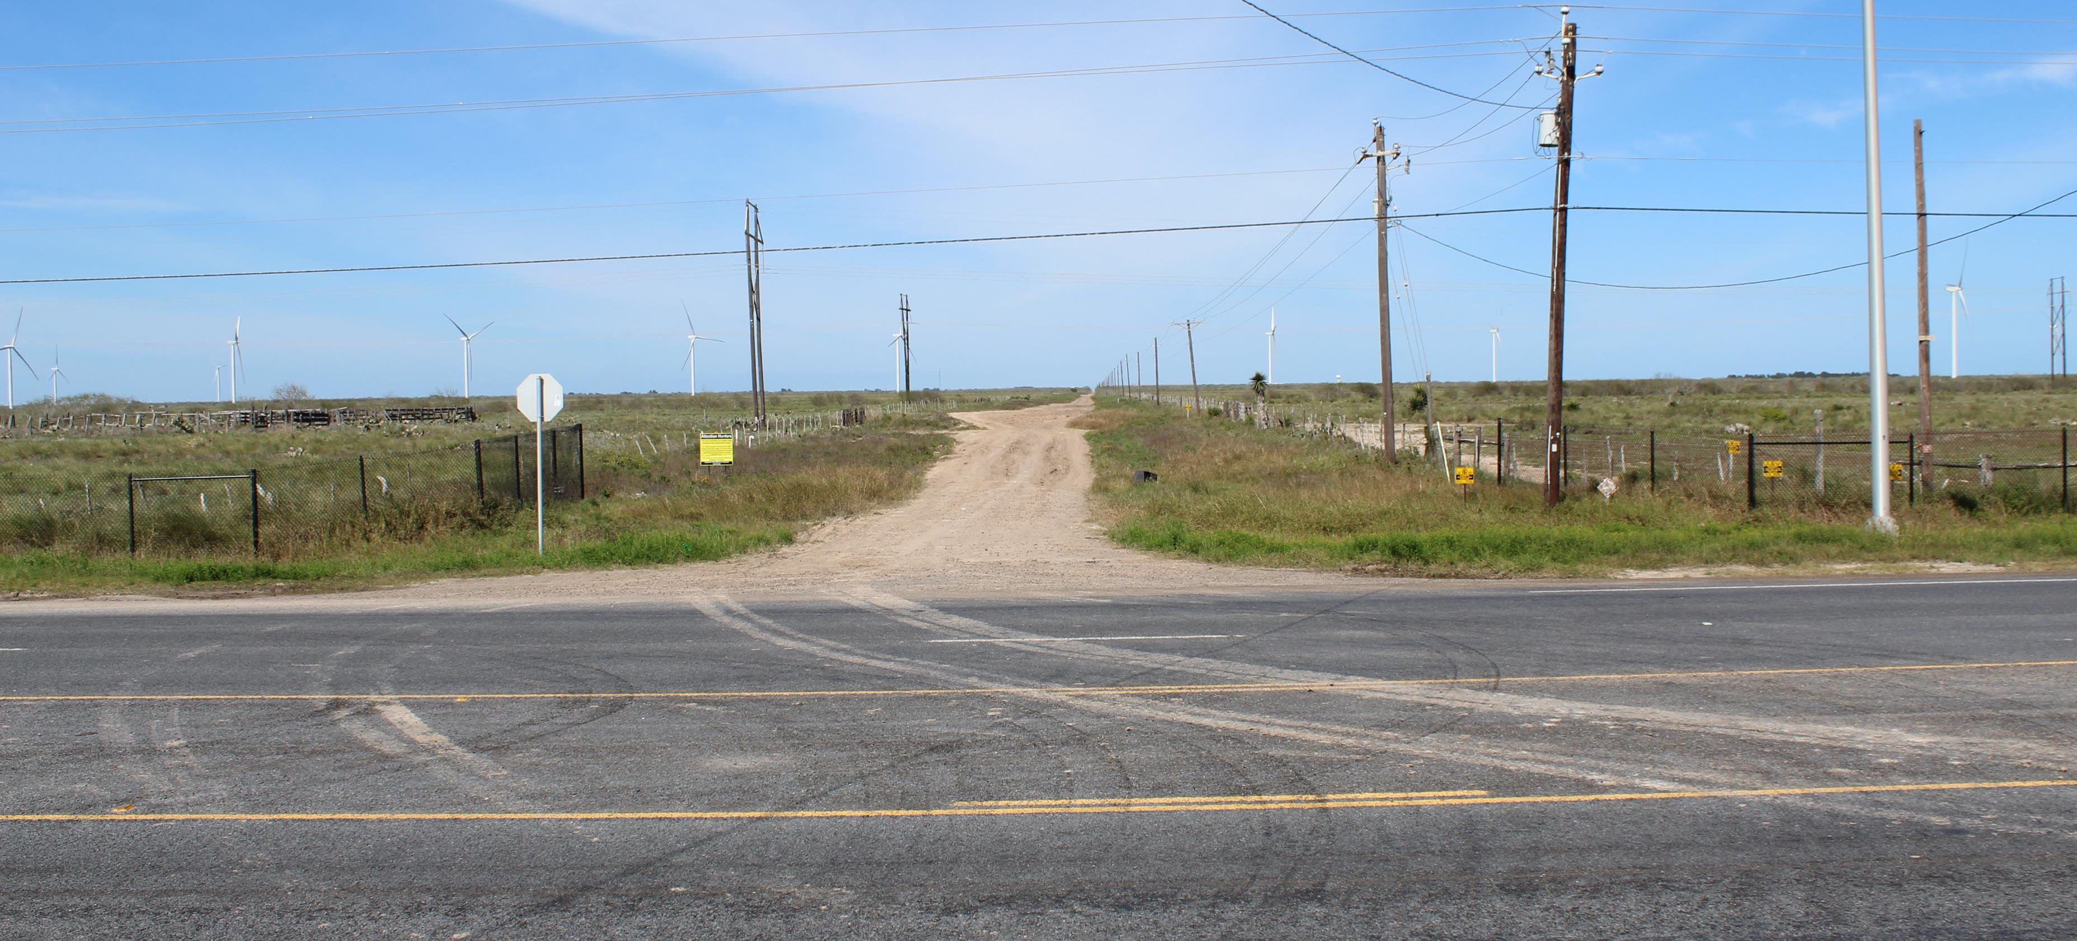
Mortality distribution changes
Gate
Wildlife Guard
Fence End
Construction of fencing is supposed to reduce mortalities
Many gaps exist in the fence at intersections with other roads
Important to know how construction of fencing changes the spatial distribution of road mortalities
Wing Wall

Slide 4
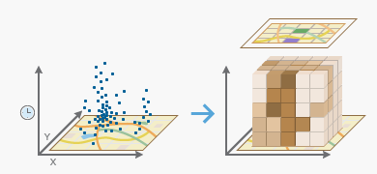
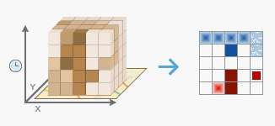
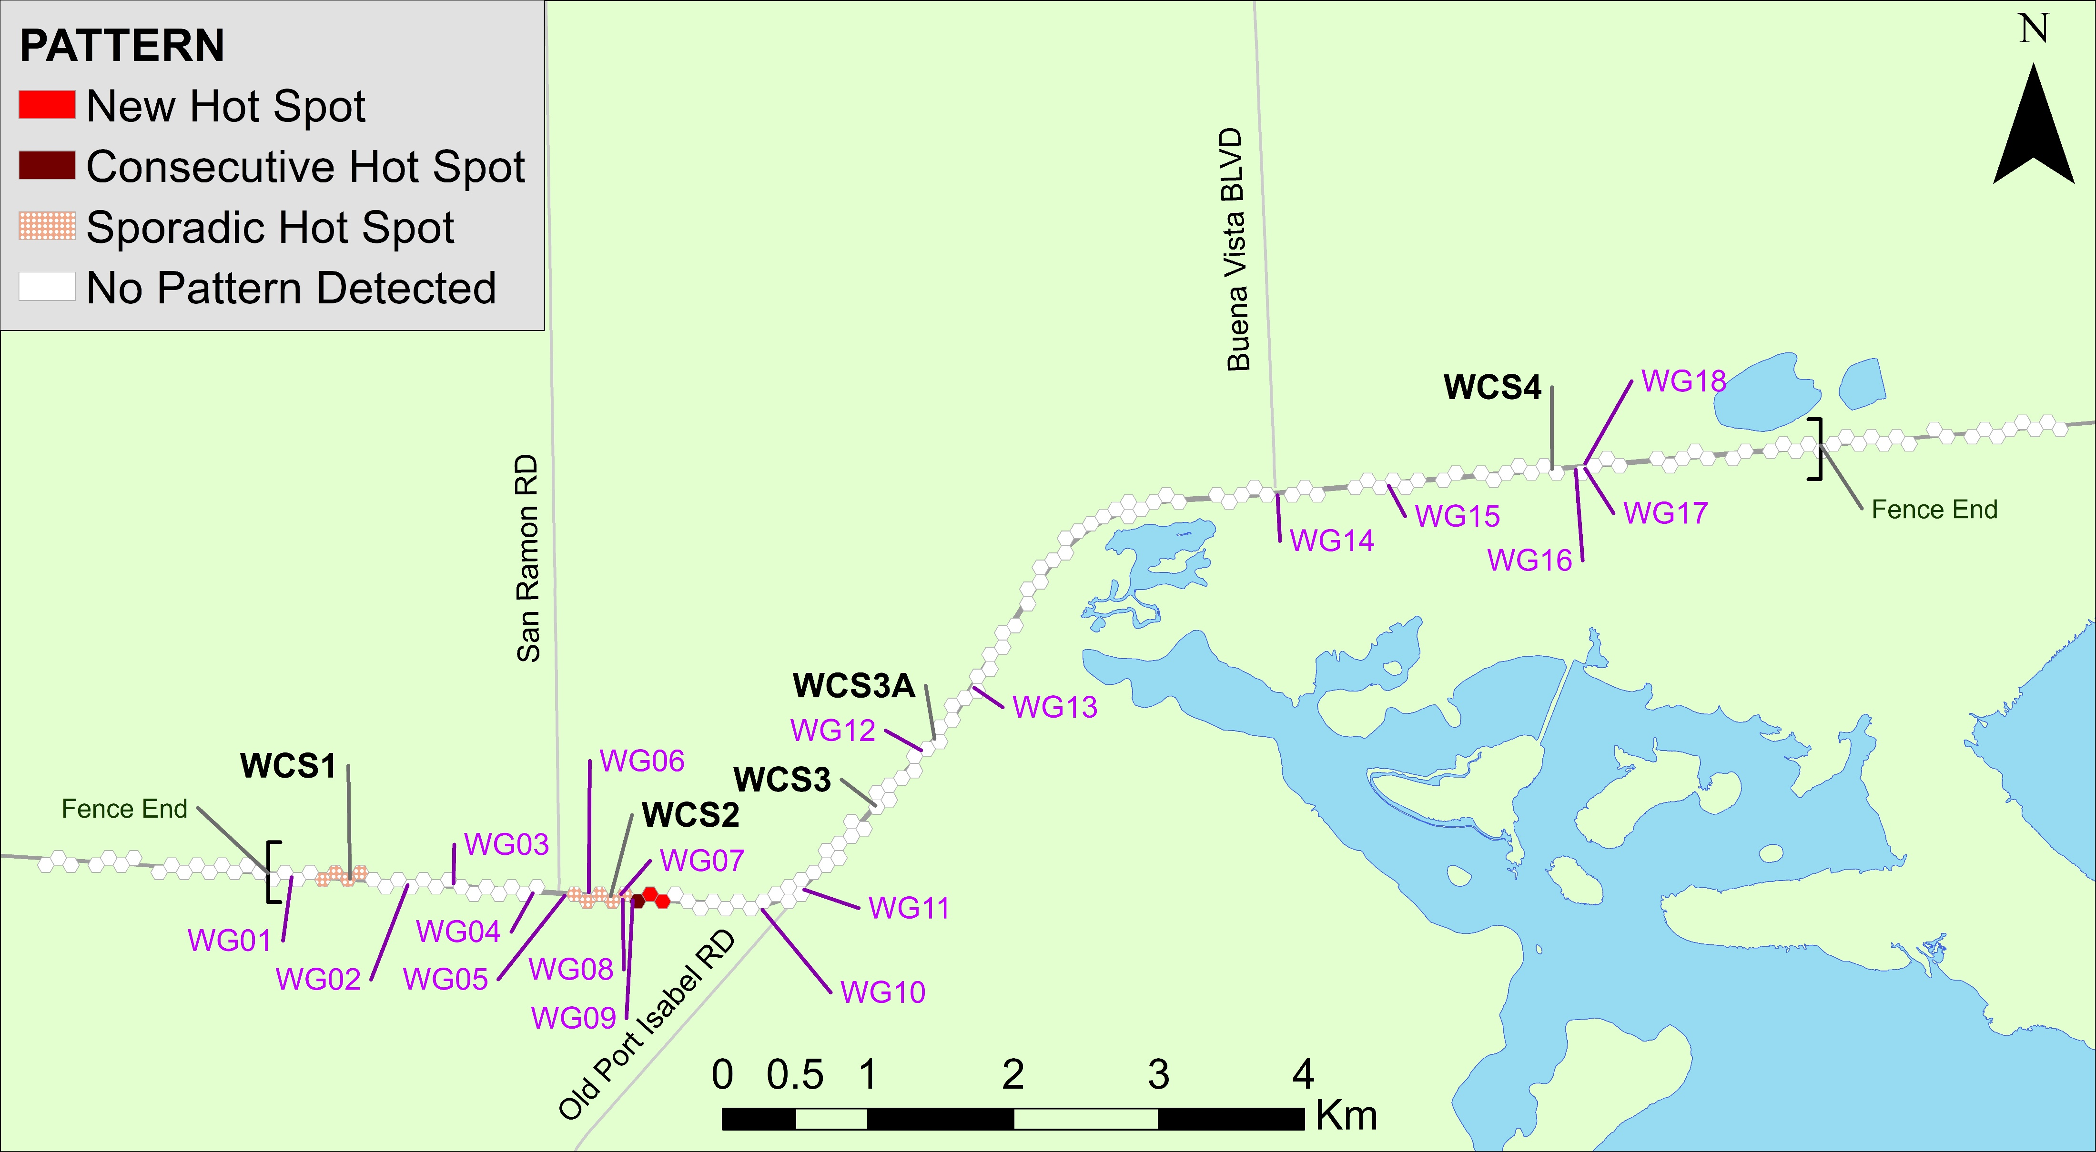
Preliminary analysis
Process
Conducted Emerging Hot Spot Analysis in ArcGIS
Converts Shapefile to NetCDF based on user defined spatial and temporal blocks
Conducts hot spot analysis using the Gi* statistic on each time slice
Conducts Mann-Kendell time series analysis to look at trends in z-scores over time

Slide 5

Flaws
Defines bins with no data throughout all time series bins as NaN
Excluded from analysis
These “gaps” are places with no identified mortalities so are true zeros
No easy way to “tell” ArcGIS that NaN = 0

Slide 6
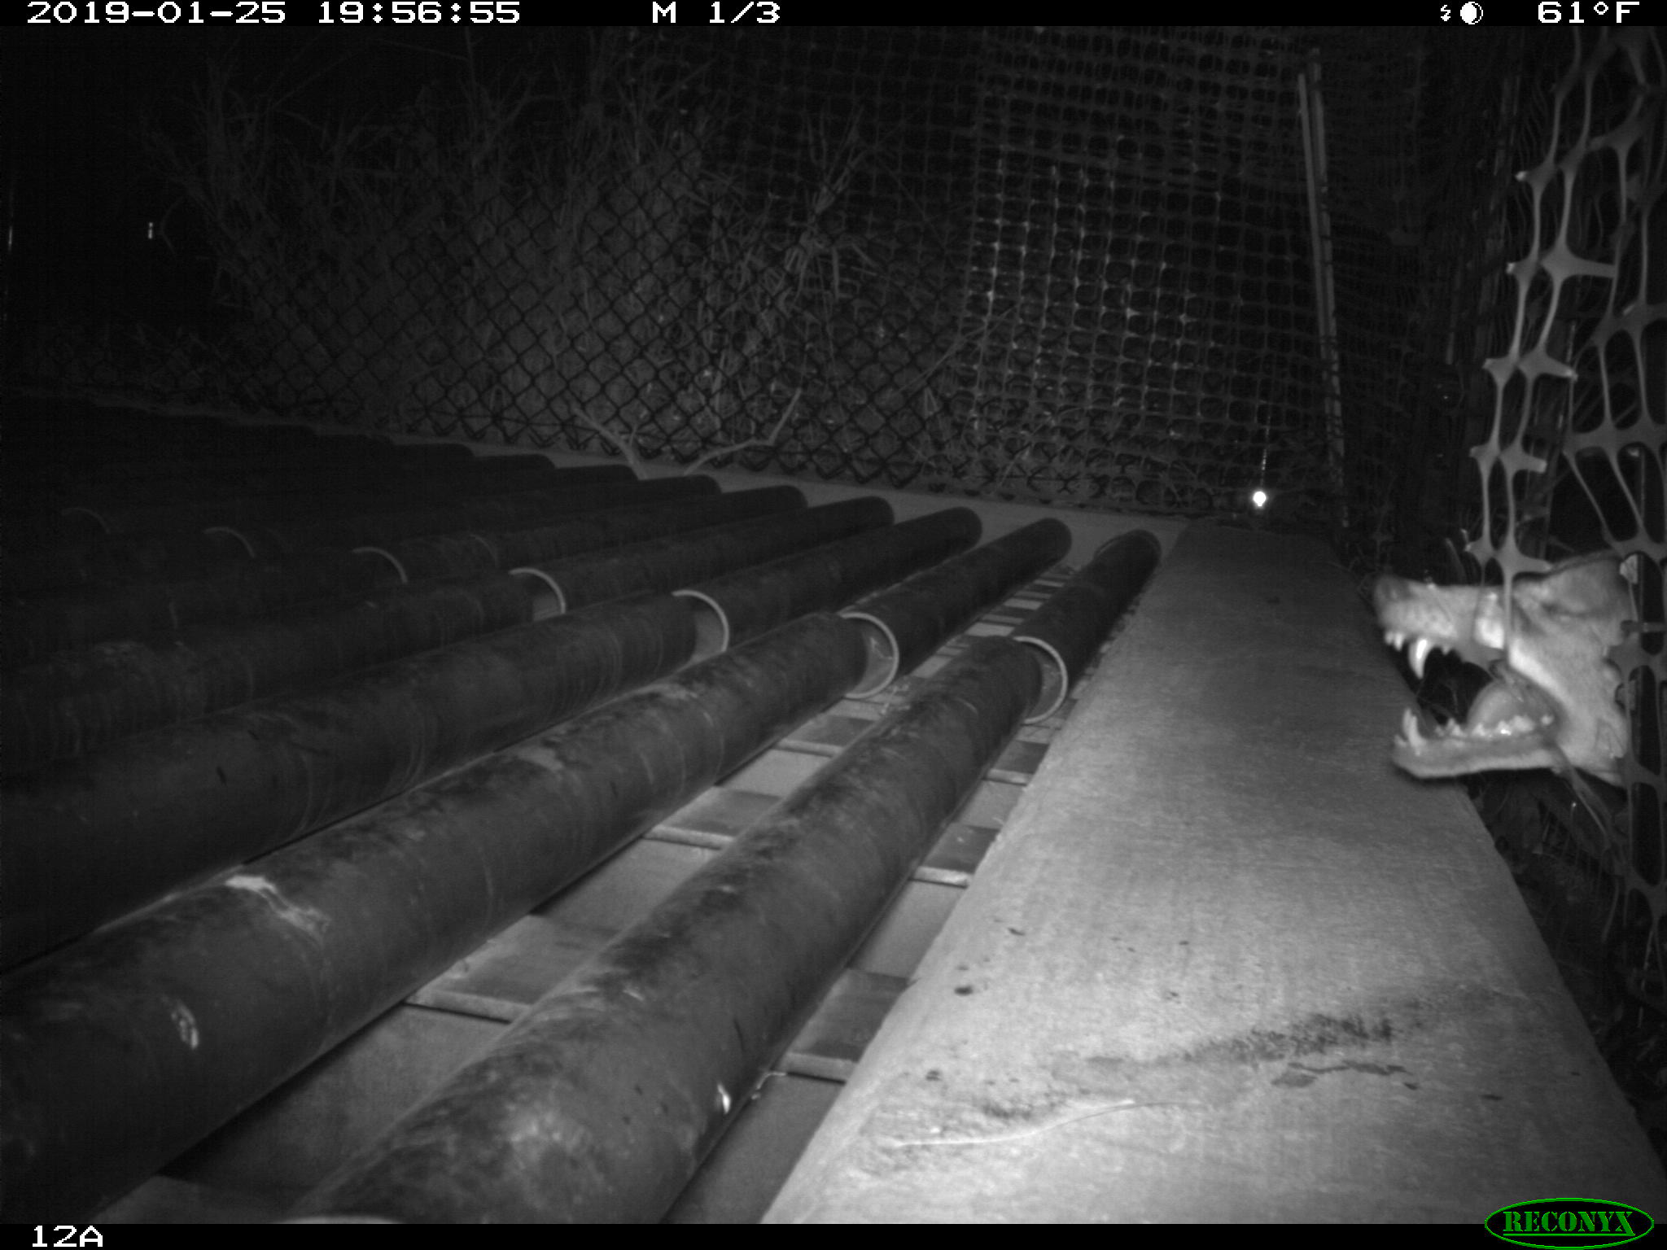
Proposed analysis
Identify packages and tools that conduct the parts of this analysis in Python
Converting data to a NetCDF file type
Hot spot analysis
Mann-Kendall analysis
Develop a program that will conduct the analysis with no data cells as true zeros instead of NaNs

Slide 7
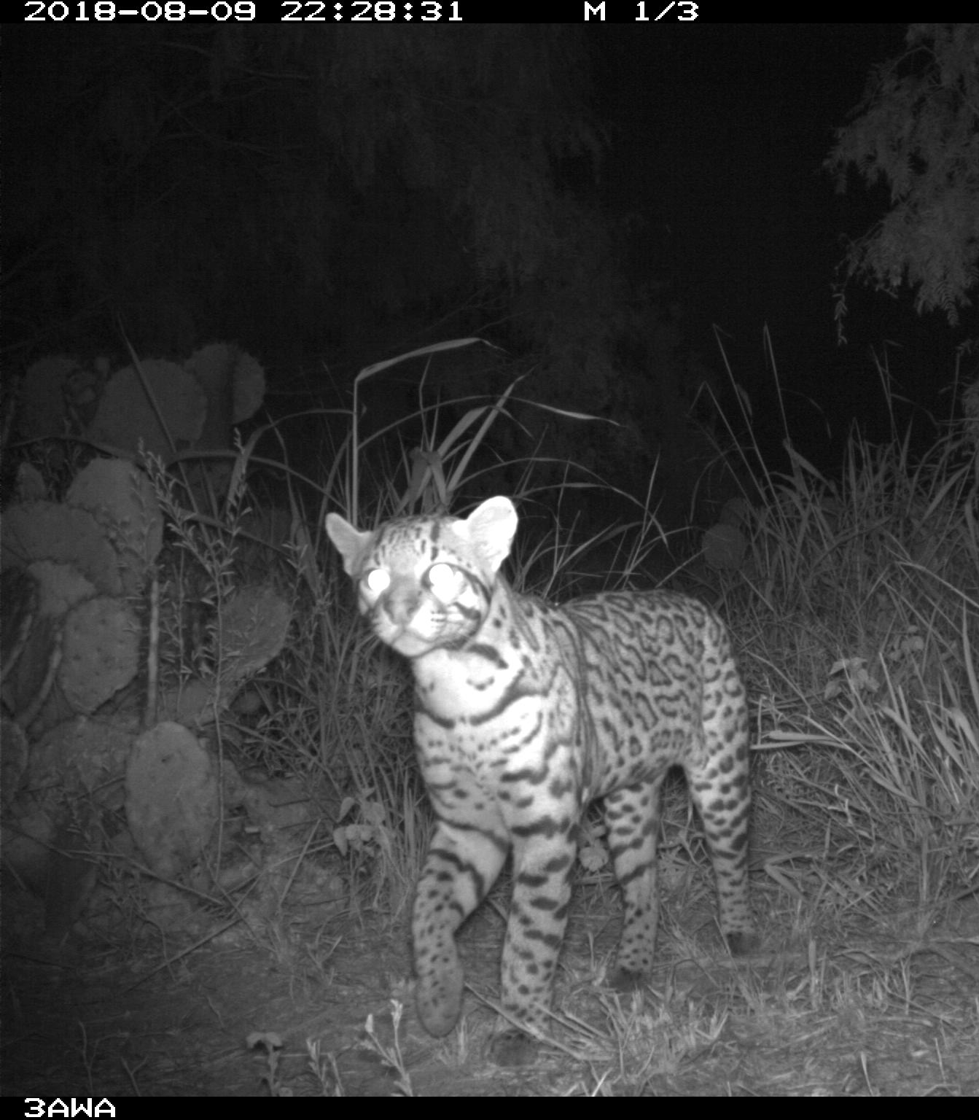
Questions

